Slide 1
MSRB SONS DAIRY — PRODUCTION & OPERATIONS
File created on: 4/13/2026 8:22:54 AM

Slide 2


Slide 3


Slide 4
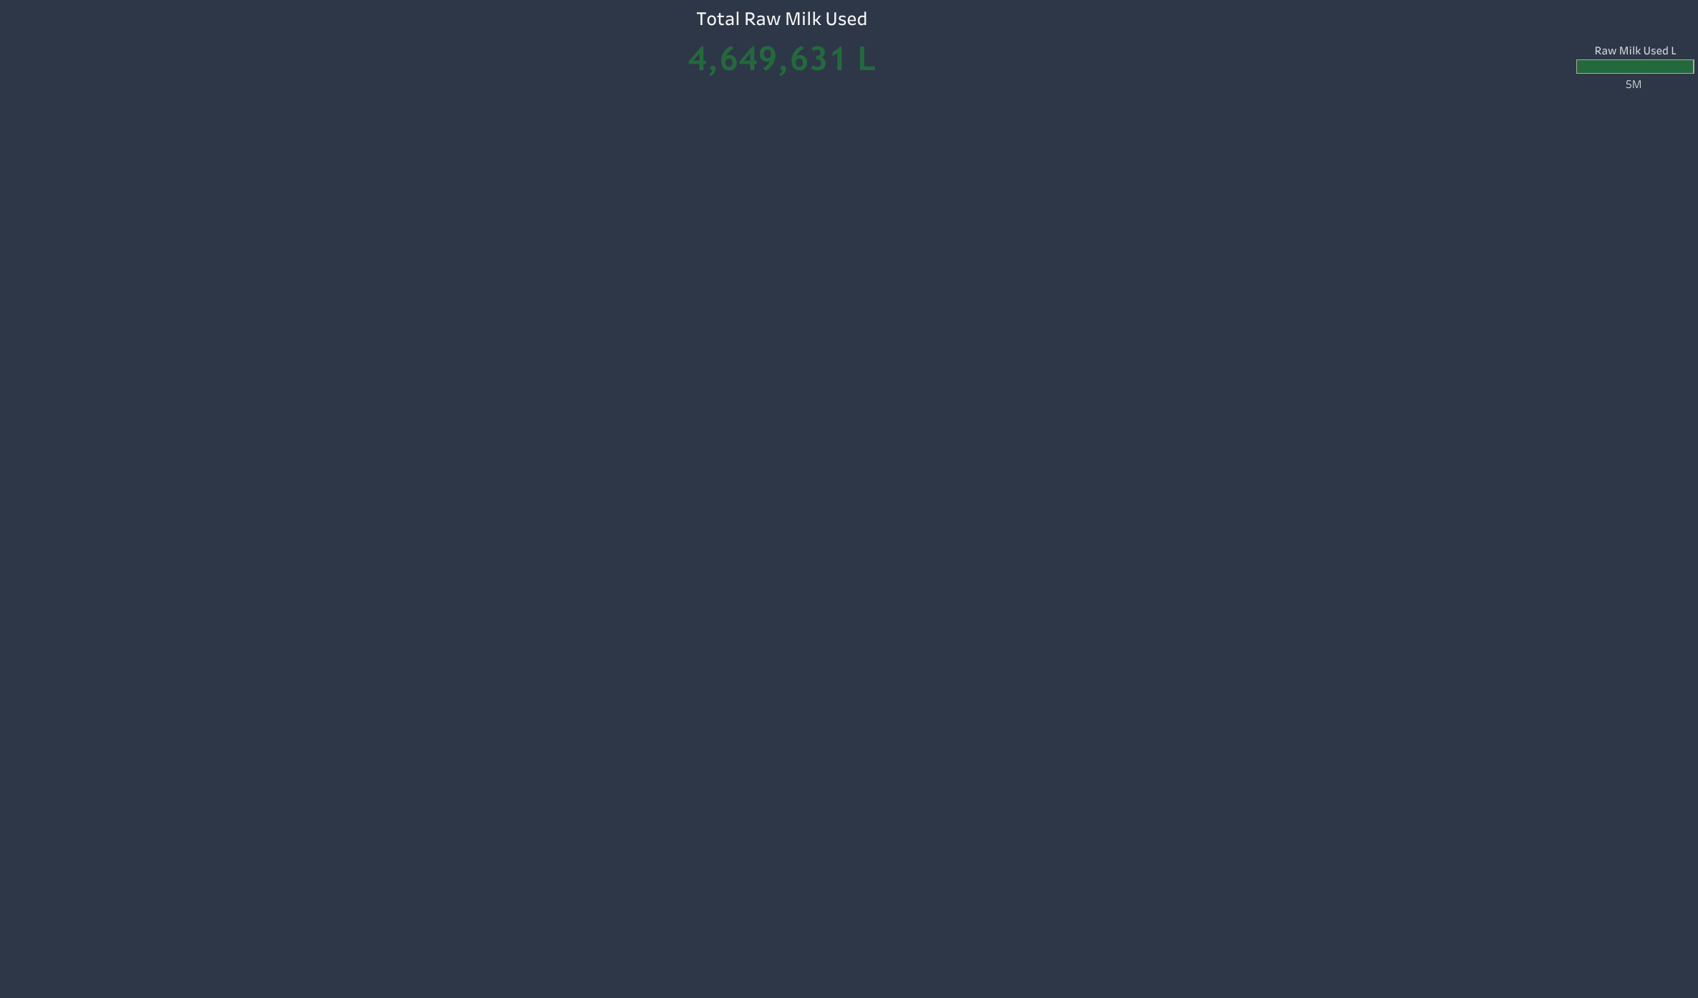

Slide 5


Slide 6


Slide 7
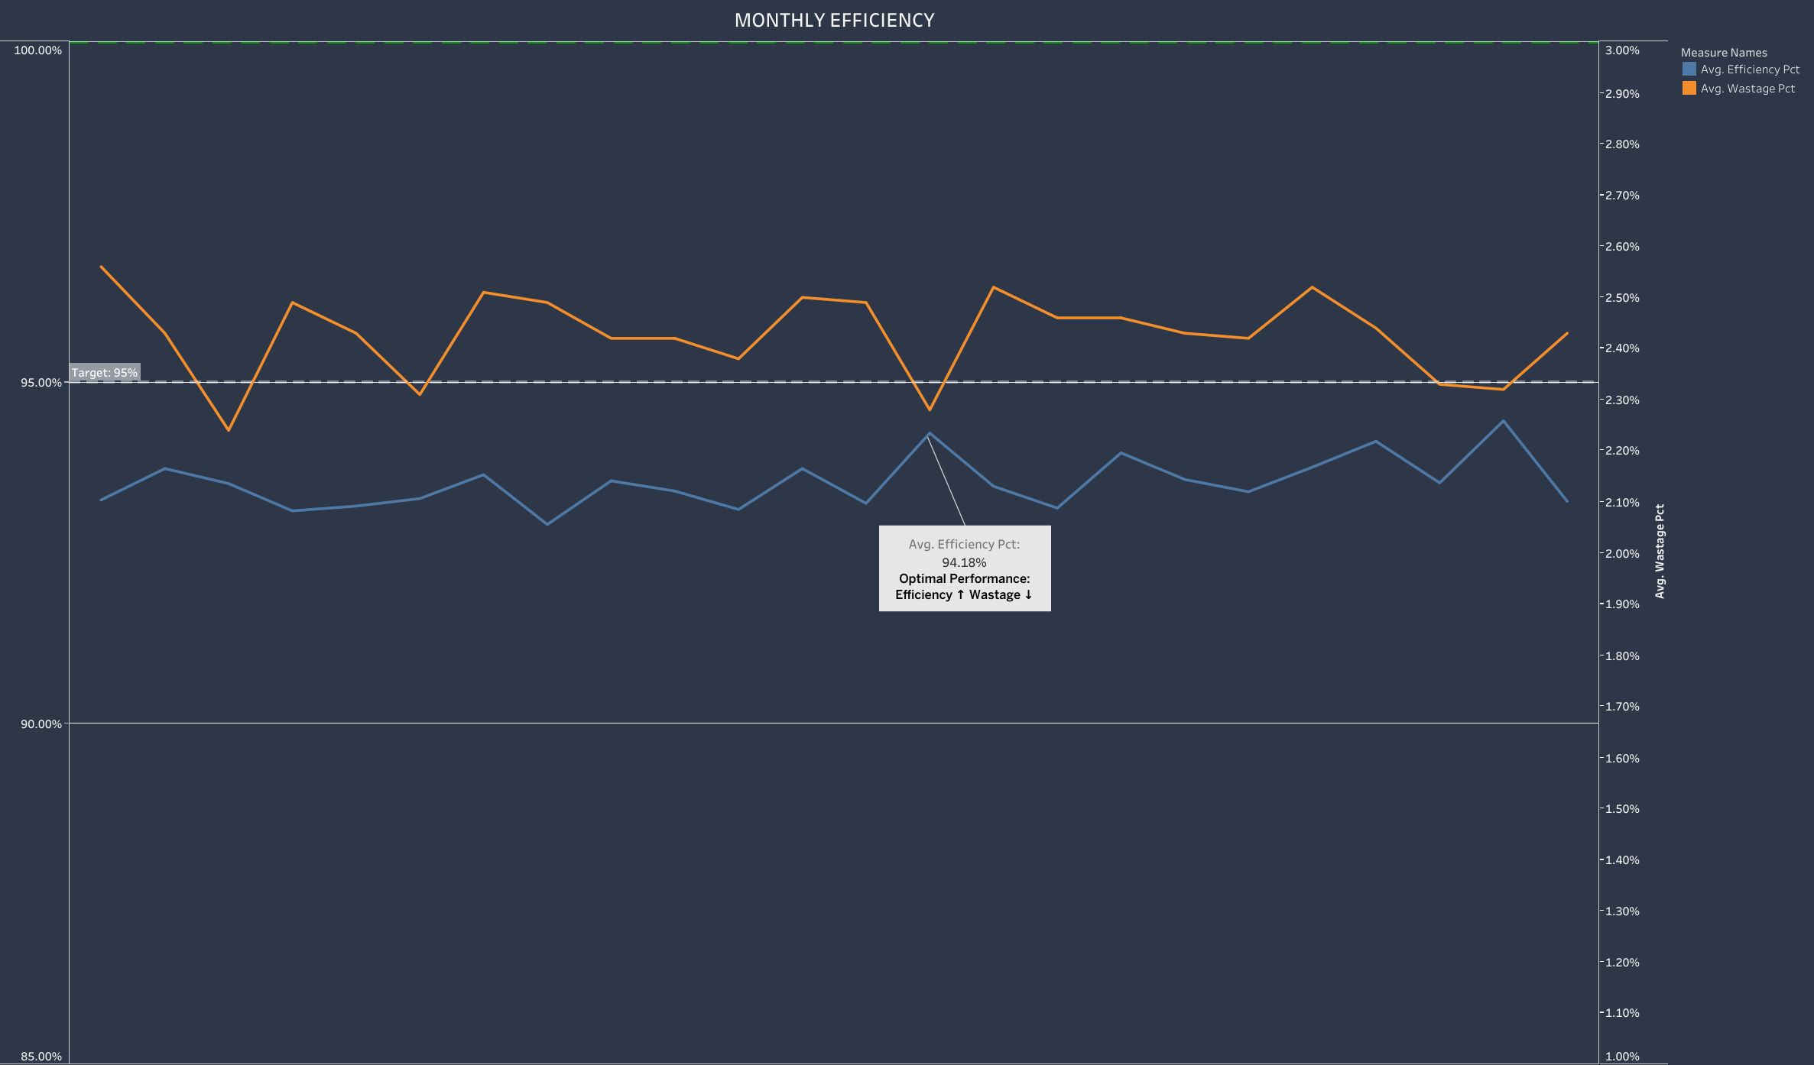

Slide 8
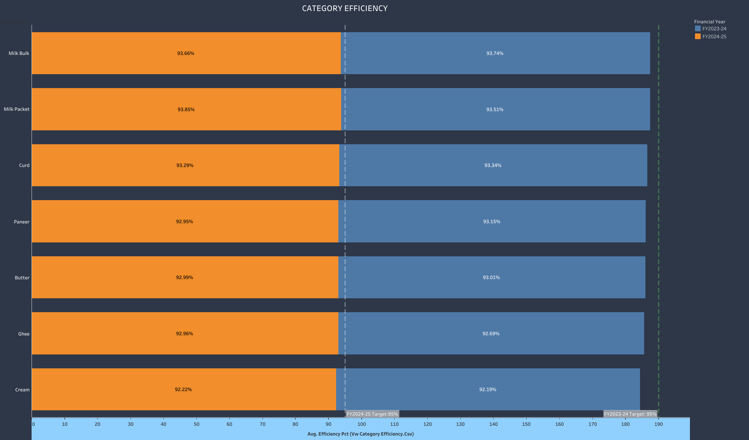

Slide 9
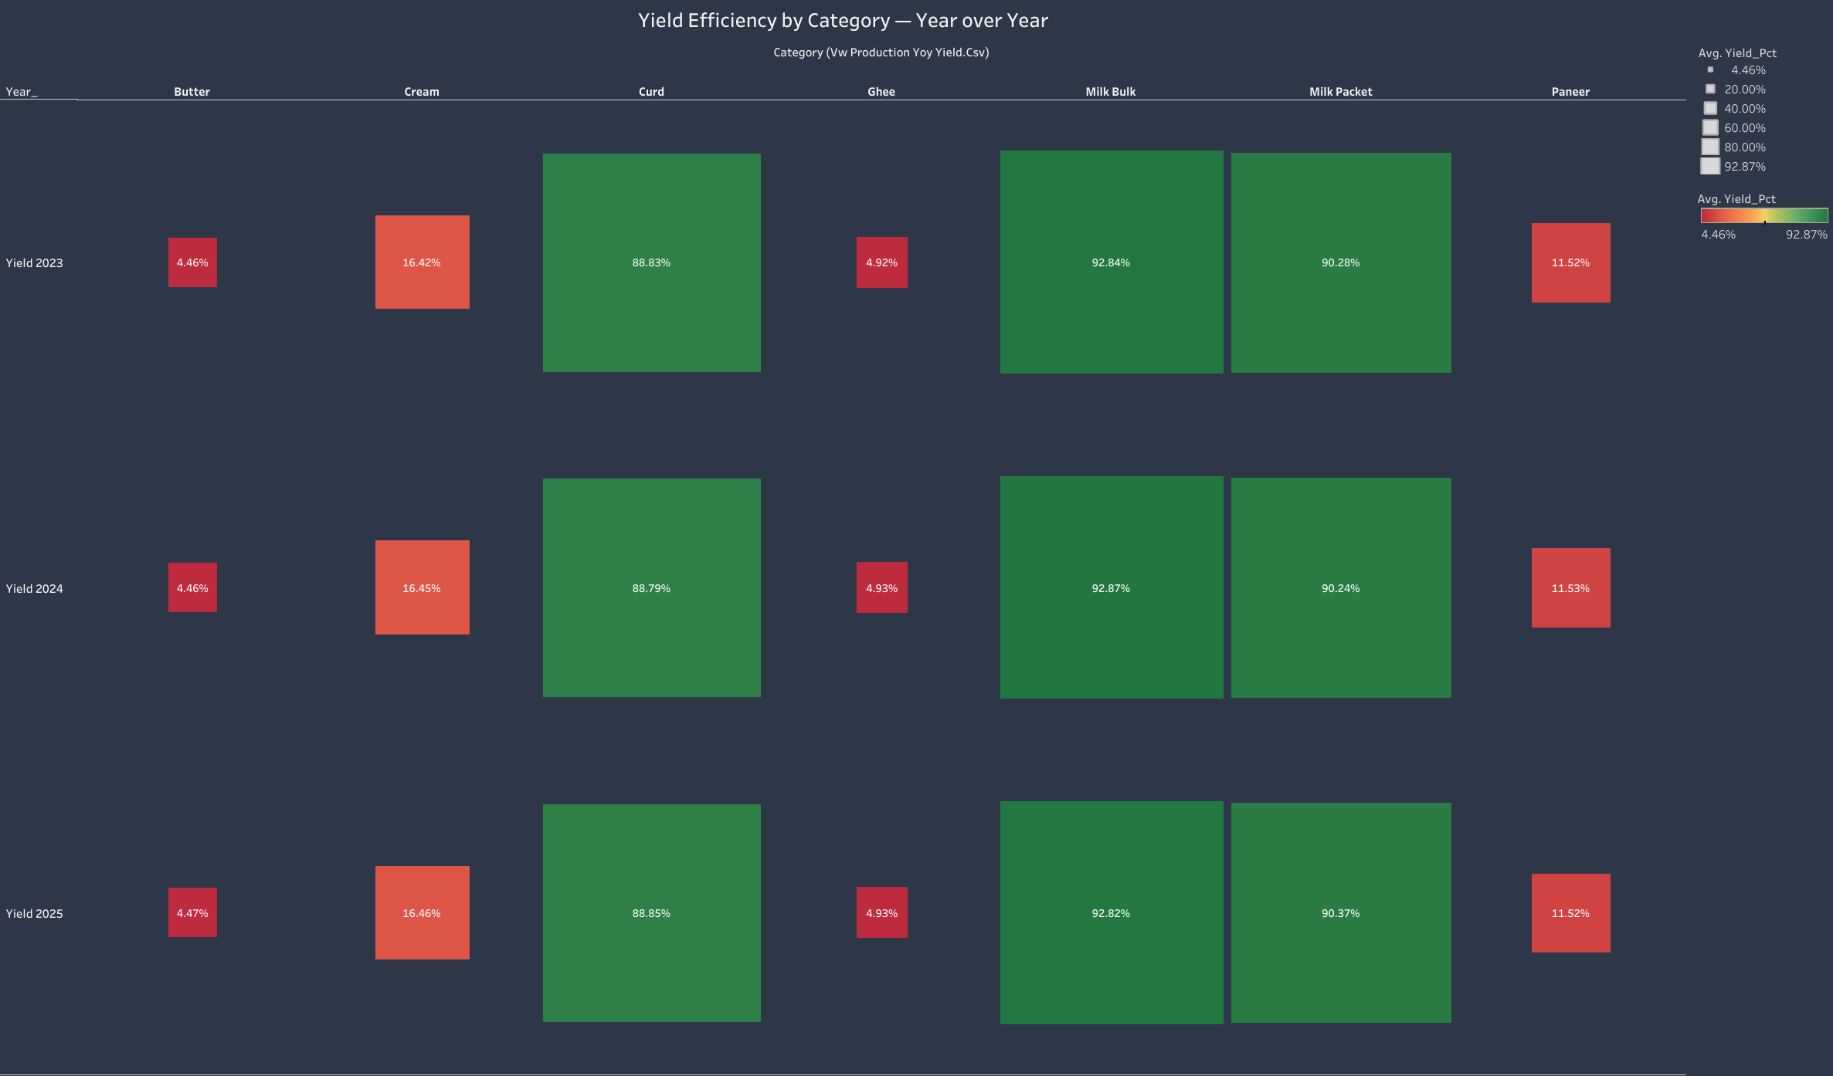

Slide 10
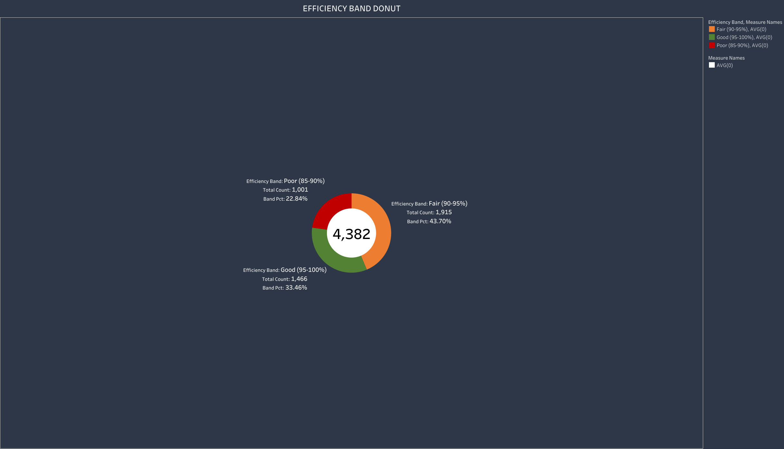

Slide 11
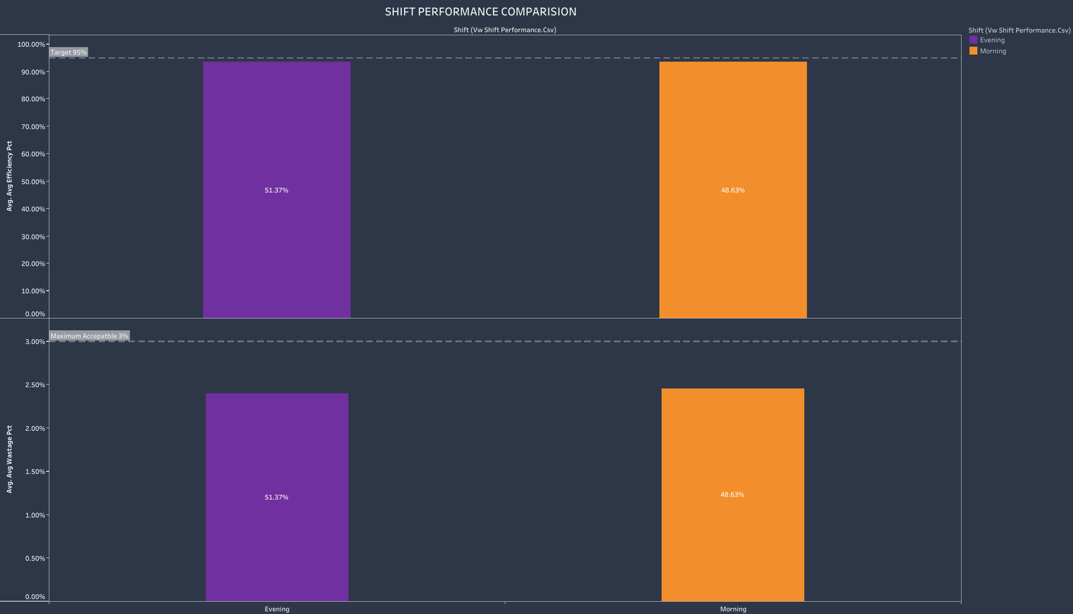

Slide 12
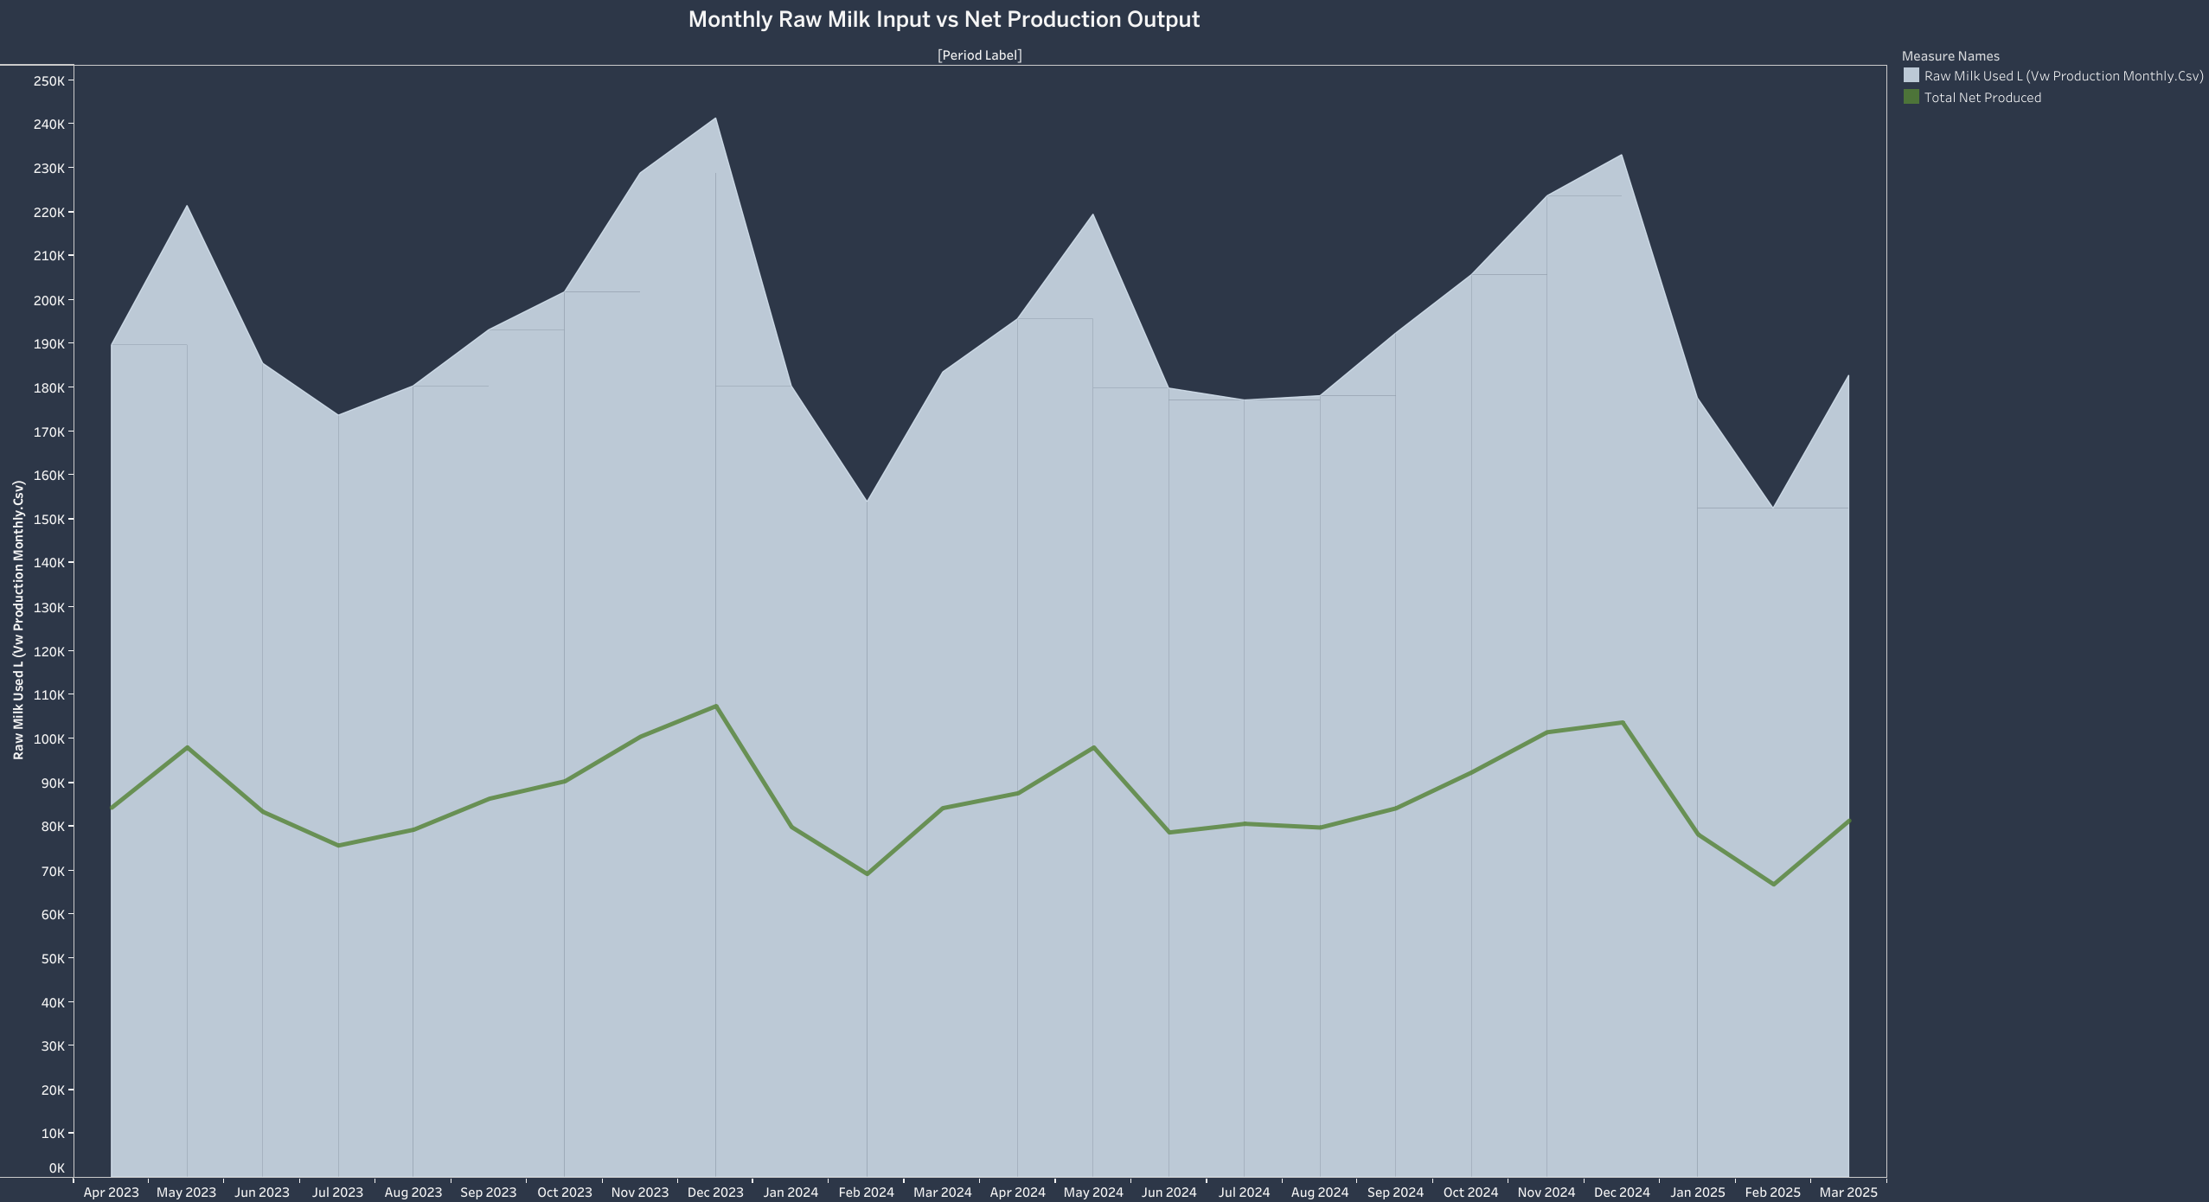

Slide 13
